Slide 1
Productionzing ML Model using MLflow Model Serving
Nagaraj Sengodan
Nitin Raj Soundararajan

Slide 2


S Nagaraj has helped build the larger enterprise-wide distributed systems. Senior Manager in Architecture and Engineering team, helping envision and deliver the future for enterprise analytics via Databricks and Azure Synapse.
Nitin Raj Soundararajan is a technical consultant focusing on advanced data analytics, data engineering, cloud scale analytics and data science.

Slide 3
Agenda
MLflow
MLflow Serving
Manage Served Versions
Monitor Served Models
Customize Serving Cluster
Q & A

Slide 4
MLFlow
Open machine learning platform
Works with any ML Library & Language
Runs the same way anywhere (e.g. any cloud)
Open interface design (use with any code you already have)

Slide 5


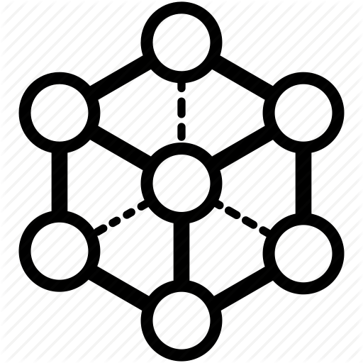
MLFlow
MLflow Tracking - Record and query experiments: code, data, config, and results
MLflow Projects - Package data science code in a format to reproduce runs on any platform
Machine Learning lifecycle
MLflow Models - Deploy machine learning models in diverse serving environments
MLflow Registry - Store, annotate, discover, and manage models in a central repository

Slide 6











MLFlow
Prep Data
Build Model
Deploy/Monitor Model
Data Science Workspace
AutoML
Batch and Streaming
ML Runtime and
Environments
Open, pluggable architecture
Online Serving
End-to-End ML Lifecycle

Slide 7
MLFlow – Model Serving
Prep Data
Build Model
Deploy/Monitor Model
Data Science Workspace
AutoML
Batch and Streaming
ML Runtime and
Environments
Open, pluggable architecture
Online Serving
End-to-End ML Lifecycle

Slide 8
Serving

Slide 9
MLflow Serving
Expose Mlflow model predictions as REST endpoint
Small cluster is automatically provisioned
HTTP endpoint publicly exposed
Limited production capability for now
For now, intended for light loads and testing

Slide 10






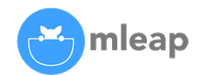






Model Serving from Model Registry
Models
Flavor 1
Flavor 2
Custom
Models

Slide 11





Model Serving from Model Registry
Models
Tracking
Flavor 1
Flavor 2
Parameters
Metrics
Artifacts
Metadata
Models
Custom
Models

Slide 12
Model Serving from Model Registry
Model Registry
Models
Tracking
Data Scientists
Deployment Engineers
Staging
Production
Archived
Flavor 1
Flavor 2
Parameters
Metrics
Artifacts
v1
Metadata
Models
v2
Custom
Models
v3

Slide 13









Model serving from Model Registry
In-Line Code
Model Registry
Models
Tracking
Data Scientists
Deployment Engineers
Containers
Staging
Production
Archived
Flavor 1
Flavor 2
Batch & Stream Scoring
Parameters
Metrics
Artifacts
v1
Metadata
Models
v2
Cloud Inference Services
Custom
Models
v3
Serving
OSS Serving Solutions

Slide 14
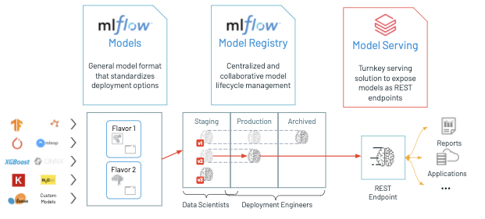
MLFlow Serving

Slide 15
Demo

Slide 16
Manage Served Versions
All active (non-archived) model versions are deployed
Manage model access rights
Source deployed model versions
Source via UI
Source via REST API request

Slide 17
Monitor Served Models
Displays status indicators for the serving cluster as well as individual model versions
Inspect the state of the serving cluster - displays a list of all serving events for this model
To inspect the state of a single model version

Slide 18
Customize Serving Cluster
Modify the memory size and number of cores of a serving cluster
Ability to add the tags
Ability to edit or delete an existing tags

Slide 19

Demo Code & Deck
https://github.com/KRSNagaraj/ModelServing-DataAISummit2021

Slide 20
Q & A

Slide 21


Feedback
Your feedback is important to us.
Don’t forget to rate and review the sessions.

